Slide 1
Technology
for Teamwork

Slide 3
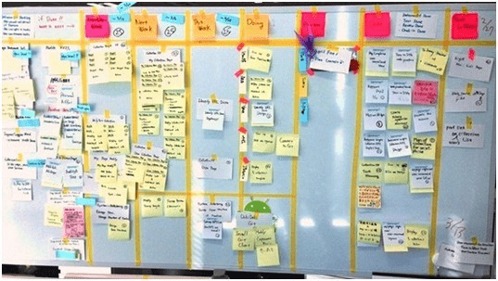

Slide 5
EMAIL

Slide 6
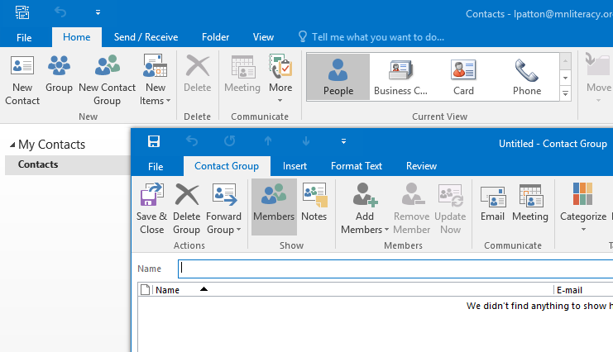

Slide 7
Group Email
How to Create Custom Groups in Outlook
Open Outlook and click on the Contacts icon in the bottom left navigation pane.
Click the New Contact Group button under the Home tab.
Under the Contact Group tab, click Add Members and select From Outlook Contacts.
Hold down the CTRL key as you select each email contact you want to add to the Contact Group.

Slide 8
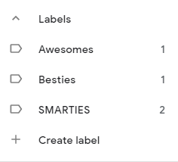
Gmail `
Create a group “label” in Contacts
Add contacts to the label
Go to Gmail and email the label (group)

Slide 9
The Power of the Shared Calendar

Slide 10
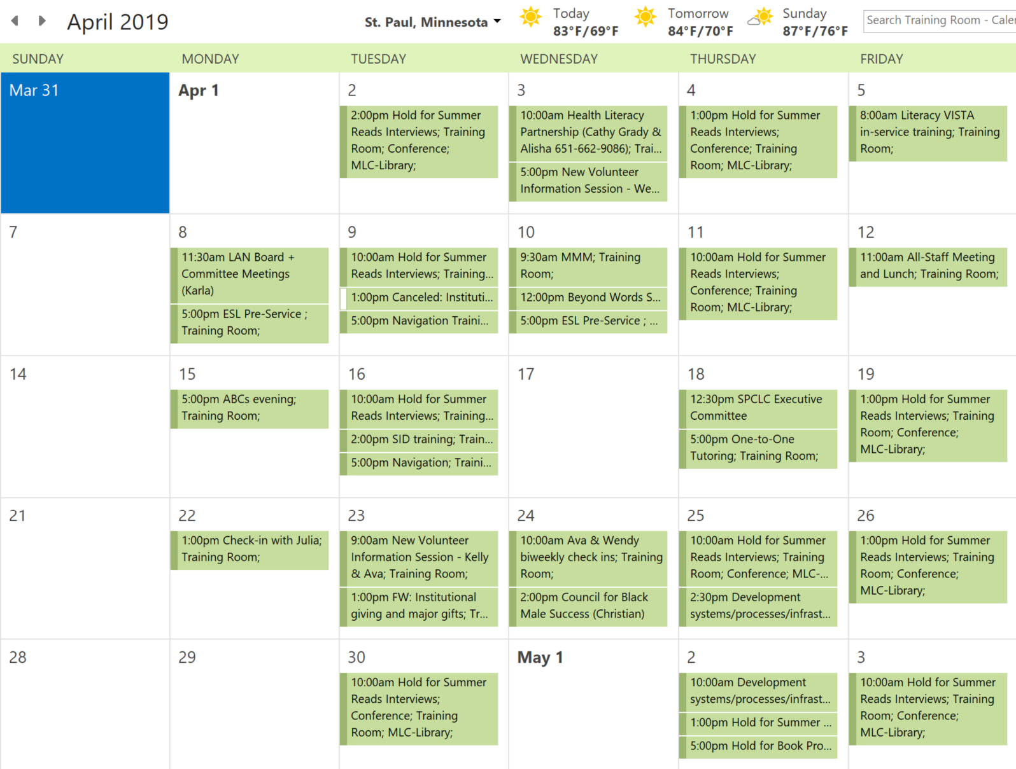

Slide 11
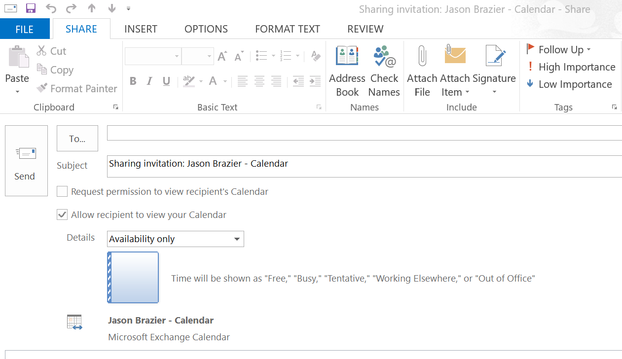
Share Your Outlook Calendar

Slide 12
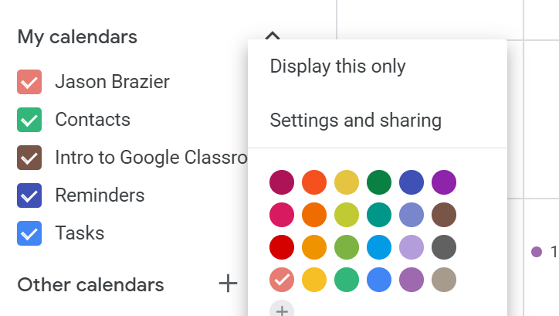
Share Your Google Calendar

Slide 13
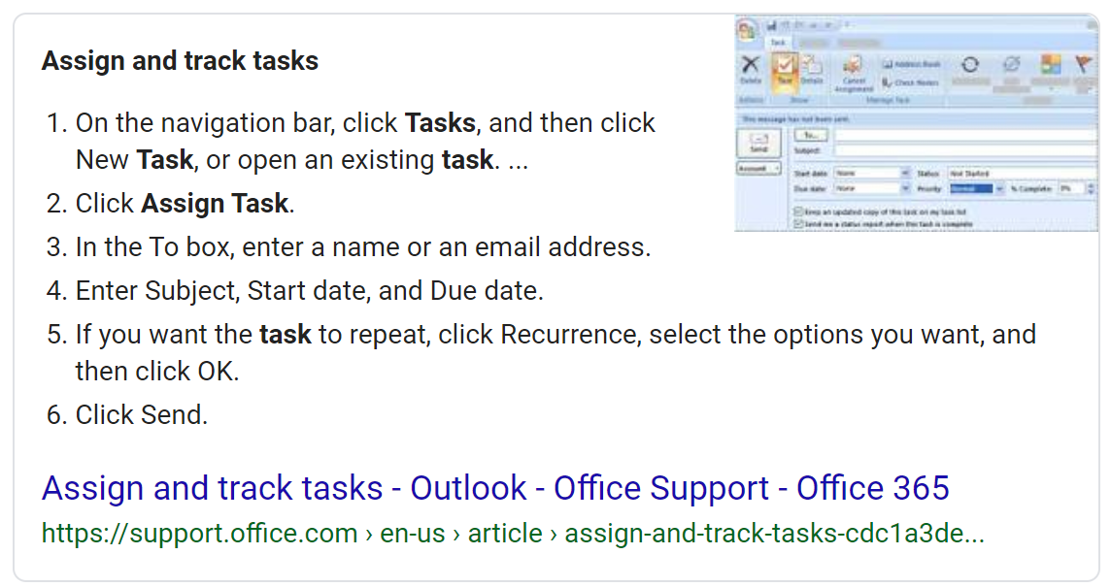
Assigning Team Tasks in Outlook

Slide 14
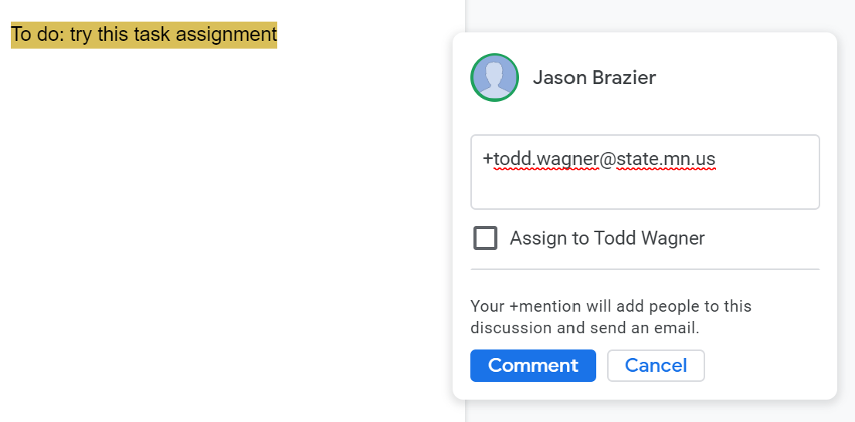
Assigning Tasks in Google Docs using Comments

Slide 16
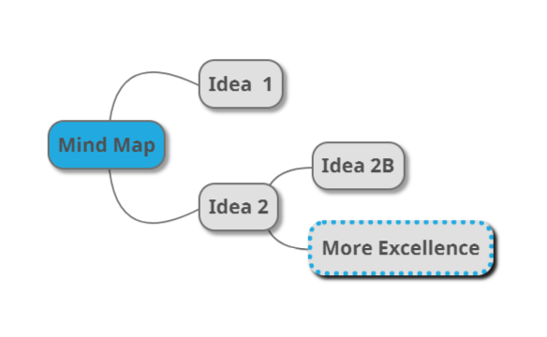
MINDMUP.com

Slide 17
Free (basic) webinar tool
https://zoom.us/
https://zoom.us/j/6353383469
Free plan limits:
40 minutes
100 people
No storage for recording
Only online support (no phone help desk)

Slide 18
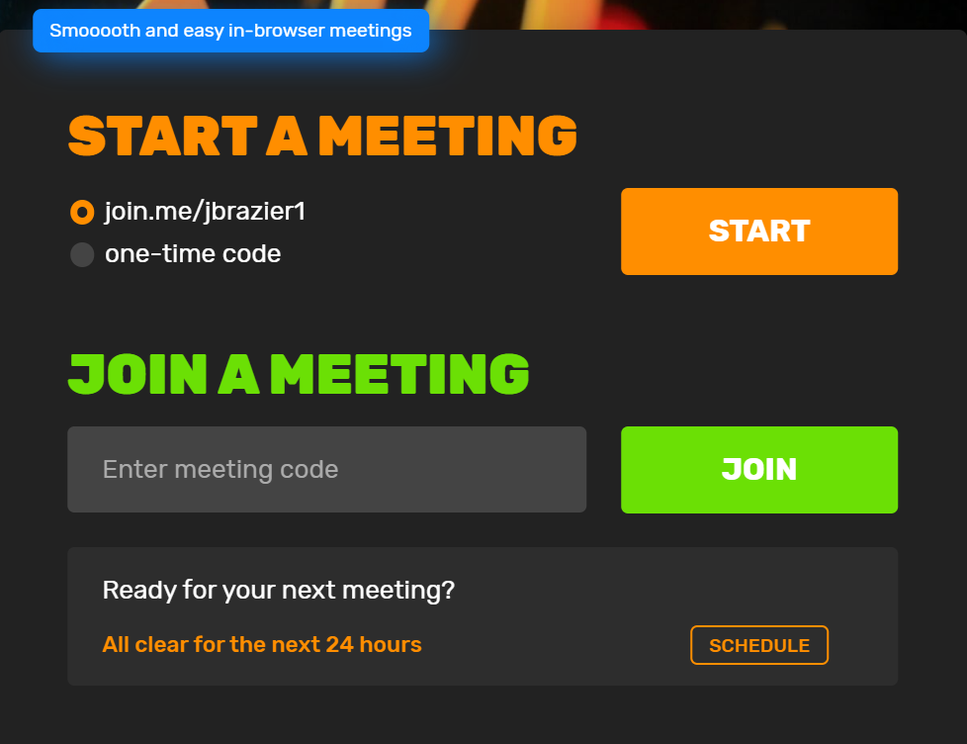
Join.me
$10 a month
5 particpants
Unlimited number & length
$25 a month
250 particpants
10 webcam streams
Recording
Scheduling
50 Gigs storage

Slide 19
OFFICE 365 Tools

Slide 20
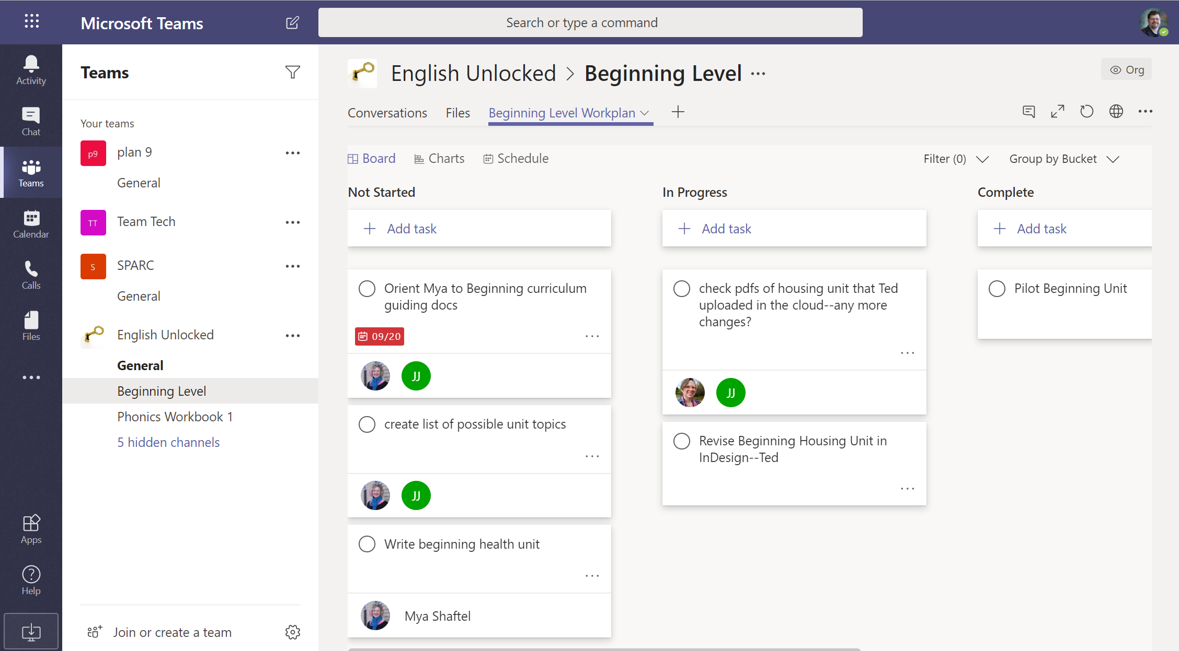

Slide 21
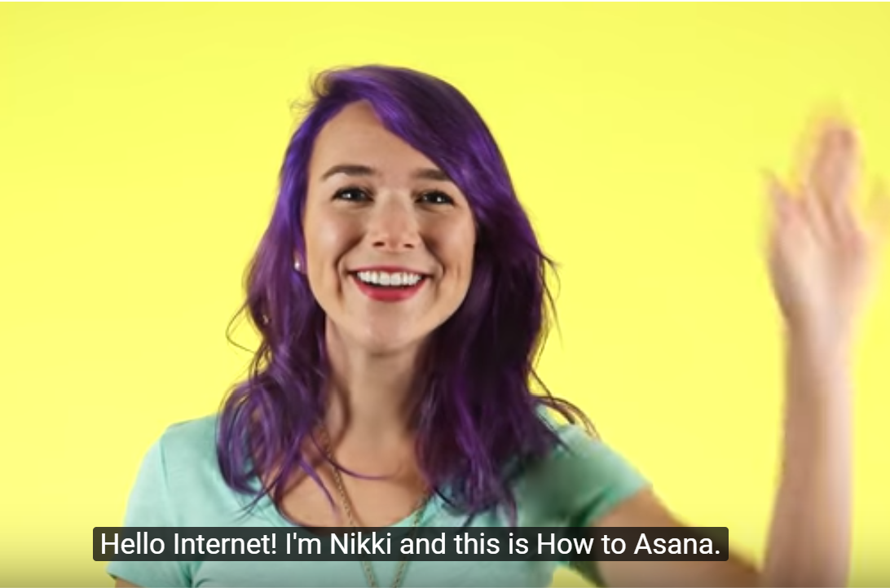
Asana

Slide 22
More Asana

Slide 23
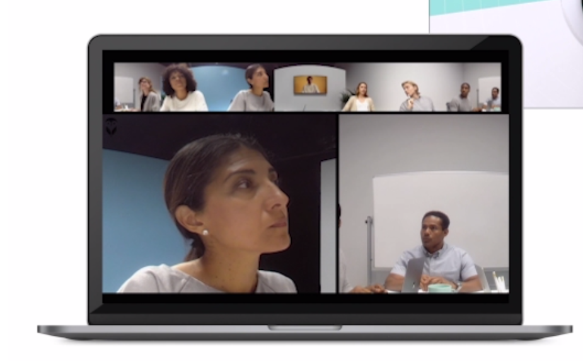
Owl camera 360 degree meeting camera

Slide 24
Thanks!
Any questions ?

Slide 25
Credits
Special thanks to all the people who made and released these awesome resources for free:
Presentation template by SlidesCarnival
Photographs by Unsplash

