Slide 1
Separating the People from the Problem: Personality and Conflict Styles
Elise M. Chambers, Esq.
Program Director, Conflict Resolution Center

Slide 2

Conflict!
Notes:
–Shout out what conflict feels like to you, how it impacts you, what happens to you when there’s conflict around you.

Slide 3
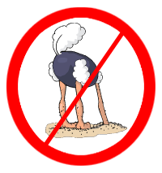
Today You’ll Learn:
Anatomy of Conflict
Personality Types
Conflict Styles
Communication for Conflict Resolution
Notes:
LIST THEMES FROM SURVEY
Seemingly biased behavior (hiring practices, promotion, employee responsibilities) by leaders
Acting on diversity as opposed to talking about being pro-diversity
The importance of a diverse work force
Calming employees or volunteers who have been victims of conscious or unconscious bias and relaying their issues to the appropriate person and giving them the tools to convey their feeling appropriately;
Explaining the need for or modifications of mechanisms that track diversity;
Addressing with leadership initiatives that prove not to foster D&I in the workplace;
Addressing/explaining cultural and geographic differences in workplace behavior and the need for accommodation and not conformity;
Addressing/explaining communication/language differences in the workplace and the need for accommodation and not conformity;
Dismantling long-term ineffective programs; and
Good diversity intentions by non-experts (inside and outside leaders) verses diversity expert knowledge (really the struggle to assert yourself as the expert in diversity verses the person who thinks they are).

Slide 4

Notes:
Sit back and relax: by lunchtime, conflicts are actually gonna make you smile.

Slide 5
Anatomy of Conflict

Slide 6

Conflict =’s
A clash of goals or values
When people care about the outcome
Perception of Conflict:
Negative bias = overwhelming, hopeless
Notes:
So, where does conflict come from?
Conflict is one of the most pervasive aspects of human affairs.
Conflict exists in almost all social relationships, regardless of context.
Part of conflict’s pervasiveness is our brain’s wiring for negative bias:
This is because of evolution: it didn’t help us survive if we remembered in great detail the 9 out of 10 times we made it safely through the jungle without encountering a lion. But the one time we almost got eaten by a lion is the time our brain needed to record in extreme detail in order to find a pattern and best protect us against that happening again.
But look at where conflict comes from again: a clash of goals WHEN PEOPLE CARE ABOUT THE OUTCOME. This means everyone involved in a conflict already has something in common – caring about the outcome.

Slide 7
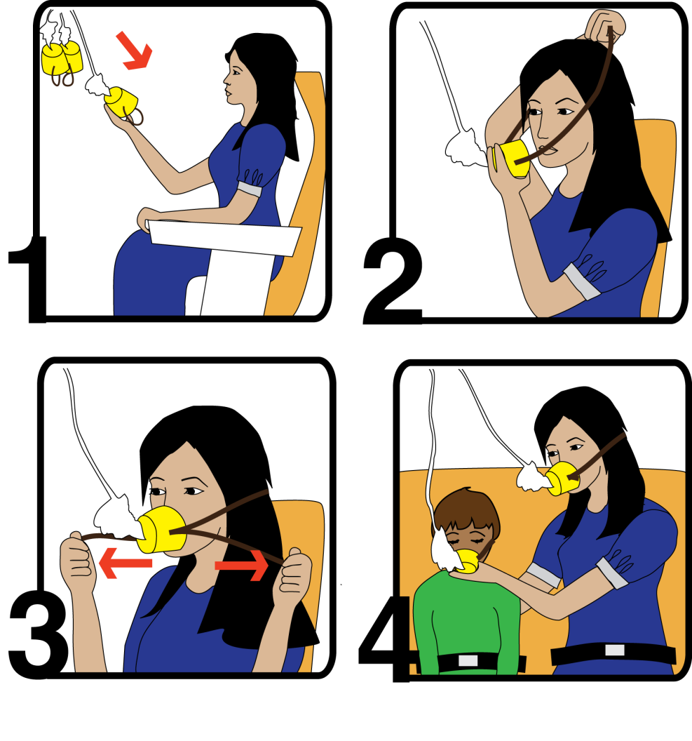
First Step in Resolving Conflict:
Secure Your Own Mask Before Helping Others
Notes:
You have to take care of your own emotional/mental state in a conflict before you can engage with someone else in the process of conflict resolution!
Likewise, your personality is the first thing you need to unbundle before you can unbundle the personalities of other participants in a conflict.

Slide 8
Four Factors Causing Conflict:
Basic Human Needs
Emotion
  Core Concerns
Identity
Biology
Notes:
People are usually able to identify the objective causes of conflict – disagreements over resources such as time, money, land, water or behaviors such making too much noise, not doing a fair share of the workload, or parenting.
Though challenging, when objective issues are the only source of the conflict, the people involved will be able to resolve the conflict without too much difficulty and generally without third-party intervention.
When a conflict becomes really difficult to resolve it is because there are subjective or symbolic factors at play. The most common ones include basic human needs, emotion, core concerns, and identity.

Slide 9
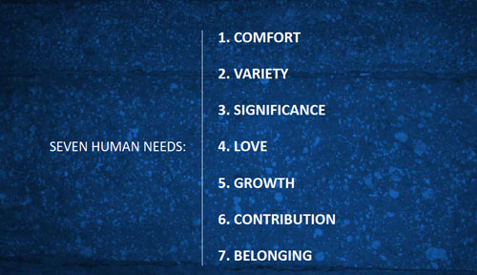
Factor 1: Basic Human Needs
Notes:
Basic human needs are a set of conditions that all humans desire , regardless of age, race, gender, or culture. Though cultural and demographic as well as personal factors do influence the priority that people give to the various needs.

Slide 10
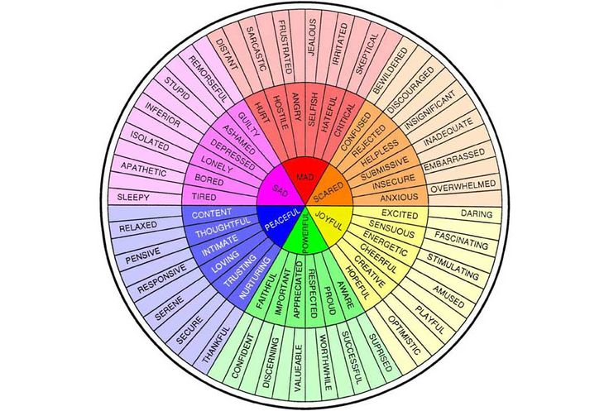
Factor 2: Emotions
Notes:
Our brains run on emotions – we’re hard-wired to respond to feelings not facts. We are physiological beings. But, although feelings are real, they are not reality.
See wheel hand out in back
How often do we use these tools when we’re feeling emotionally overwhelmed in a conflict?
Express your feelings.
Unbundle your emotions – people from the situation.
Explore your emotional footprint.
Separate feelings from judgments.
Negotiate with your feelings.
Acknowledge their feelings.
The research on social and emotional intelligence (Daniel Goleman) shows us how critical emotional connection is for humans for function, so it makes sense that emotional upset feeds into interpersonal conflict.

Slide 11


Emotions and Needs Combined: Core Concerns*
4. Status:
5. Role:
From: "Beyond Reason: Using Emotions as You Negotiate" by Roger Fisher, coauthor of the bestselling "Getting To Yes" and Daniel Shapiro, associate director , Harvard Negotiation Project
1. Appreciation:
2. Affiliation:
3. Autonomy:
Notes:
Emotion is a critical factor in resolving conflict. It is helpful to look at what generates these emotions. Core concerns are human wants that are important to almost everyone in virtually every conversation about conflict. They are often unspoken but are no less real than our tangible interests. By dealing effectively with these concerns, you can stimulate positive emotions.
Appreciation
resulting emotions can be enthusiastic, affectionate, cheerful, and caring
person feeling these emotions will often be prone to cooperate more
person who is unappreciated will often feel angry and disgusted
Affiliation
person is treated as a colleague they tend to feel more amused, compassionate and ecstatic
tend to make a person more prone to work together
person who is treated as an adversary is more apt to feel resentful or irritated
will be more prone to go it alone rather than work together.
Affiliation describes the sense of connectedness with another group or person.
Autonomy
person's freedom to decide is acknowledged, emotions such as being proud, happy, and accomplished
emotions tend to make a person prone to being creative.
On the other hand, when autonomy is impinged, the emotions of guilt, shame, and remorse often arise, leading to a person thinking more rigidly.
Status
feel more calm, relieved, and relaxed
tends to make a person more prone to be trustworthy.
When a person's status is put down they will feel humiliated and embarrassed.
People with these feelings often are more prone to act deceptively and be seen as untrustworthy. (Note that they are seen as untrustworthy, not necessarily actually untrustworthy.)
"Status refers to our standing in comparison to the standing of others" (95).
Role
When role is fulfilling and includes activities that illustrate and convince the person that they make a difference, feelings of hope
When a person's role is trivialized and restricted they may feel envious, jealous, or become apathetic.

Slide 12
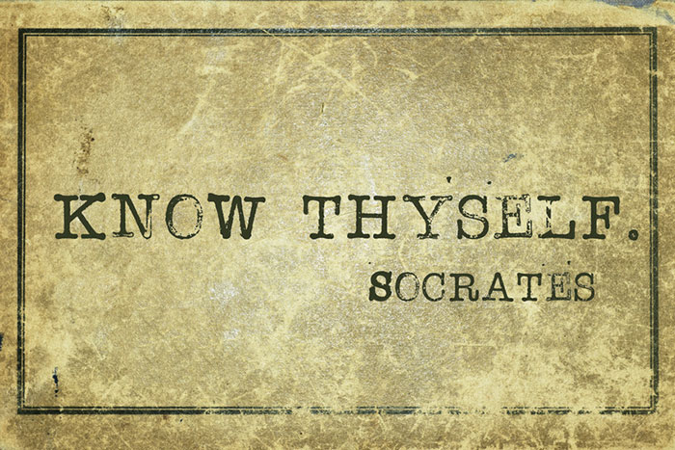
Factor 3: Identity
The story we tell ourselves about ourselves.
Our sense of who we are in the world.
The sense of self, providing sameness and continuity in personality over time.
Notes:
Research from the Harvard Negotiation project and many other sources has shown that almost all people are very concerned about these three identities. People have a deep and enduring need to feel:
that they are competent,
good,
and worthy of love.
Answer this question: If I know nothing else about myself, I know I am the kind of person that is ____.

Slide 13
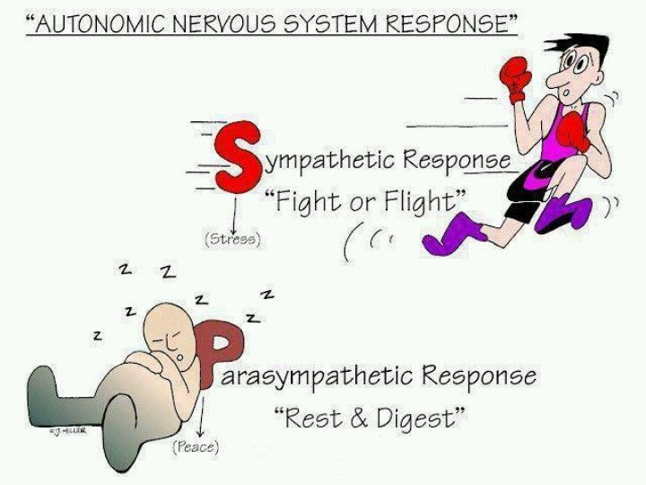
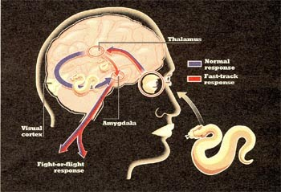
Factor 4: Biology:
Notes:
Nervous system has two modes – parasympathetic and sympathetic, also known as “rest and digest” and fight, flight or freeze”.
Normally, we want our Parasympathetic response turned “on”. This is the mode in which we can think, be creative, problem-solve, collaborate together.
But during stress or conflict, our Sympathetic system gets switched “on”, and suddenly we can’t think anymore.
Gas burner on stove – cooking soup: Simmer versus High… what happens if you leave soup on high for hours? What about simmer? Our bodies can’t handle having the SNS in the on position for hours, days, weeks at a time – we burn up.
This reaction is also known as Amygdala Hijacking. 10 seconds; 6-8 hours.

Slide 14
Personality!
Notes:
self-awareness tools and engagement responses

Slide 15
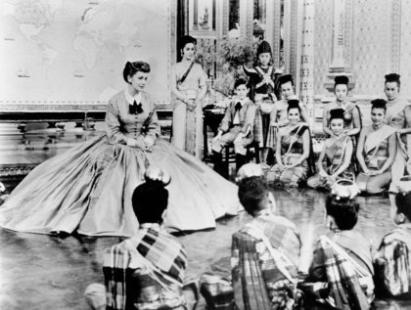
Getting to know you… getting to know all about you:
Meyers-Briggs
Center for Conflict Dynamics “Hot Buttons”
Notes:
Understanding One’s own Reactions to Conflict
It is especially crucial for conflict competent leaders to understand and embrace their own strengths and developmental opportunities in regard to conflict. For leaders, it is of utmost importance to be aware of your personal reactions to conflict so you can manage your responses and model the most effective behaviors before, during, and after conflict.

Slide 16
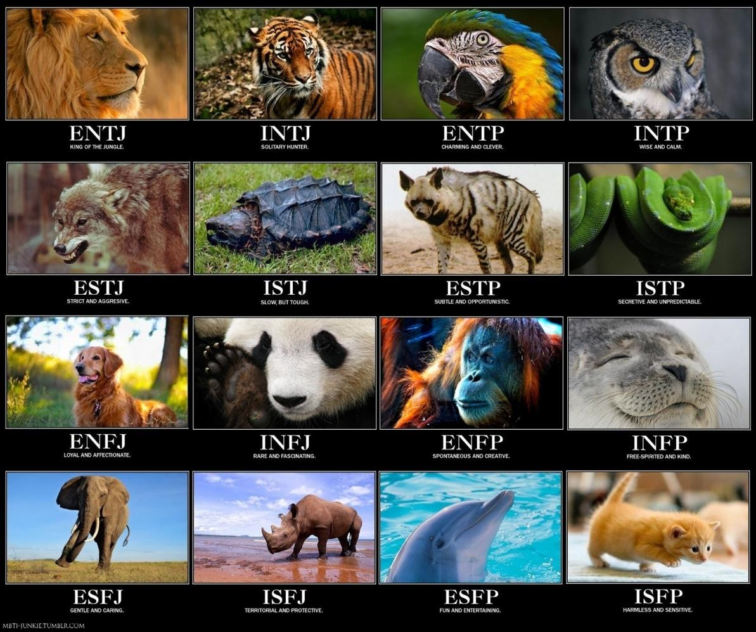
Notes:
Hand out and do exercise
I’s on one side of room; E’s on other
S’s and N’s
F’s and T’s
J’s and P’s

Slide 17
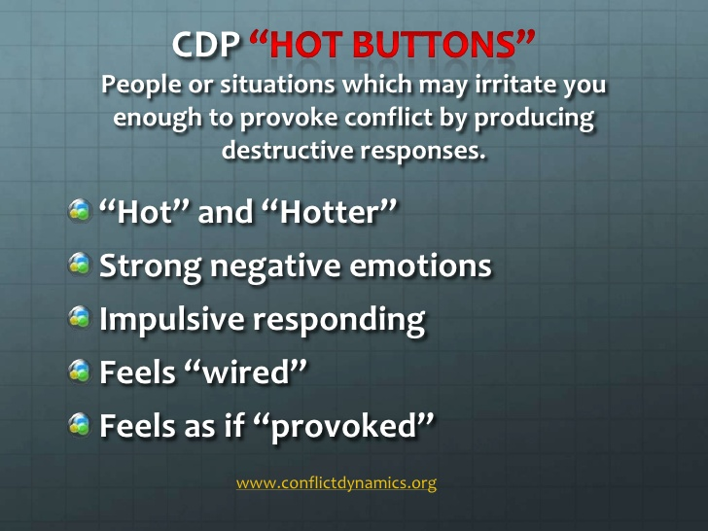
Notes:
9 total – see hand out in back

Slide 18
Conflict Styles

Slide 19
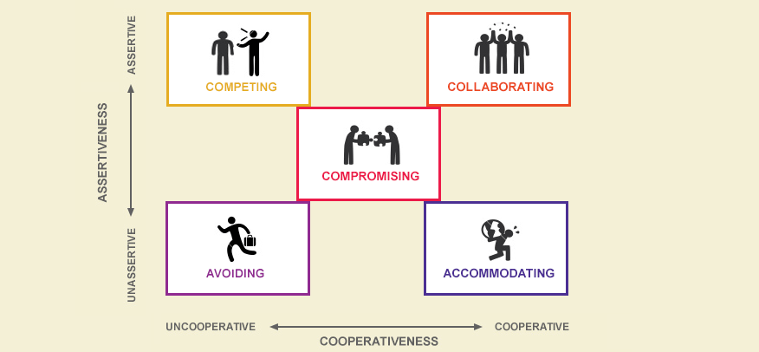

Slide 20
Communication for Conflict resolution

Slide 21
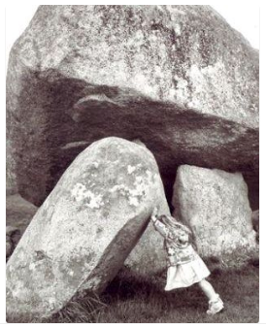
Courageous Conversations
What they are:
What they are NOT:
An open, authentic, truthful dialogue, held in an atmosphere of trust and respect
A conversation with a clearly defined objective that is action-oriented
  Playing devil’s advocate
  Advocating for your opinion
  A chance to say “I Told You So”

Slide 22
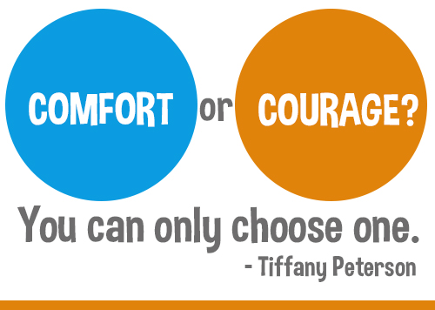
Courageous Conversation Protocol
Prep
Permission
Focus
Plan
Review
Notes:
Many “right ways” to organize a Courageous Conversation – this 5 point list is a compilation of a couple different styles, but is comprehensive

Slide 23
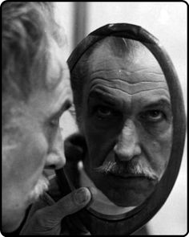
Prep
Check Your Intentions
Clarify Your Part
Practice Starting
Put Yourself in the Other Person’s Shoes
Remind Yourself of a Positive Outcome
Notes:
Check your intentions:
Why do you want to have this conversation?
What’s your goal? What do you hope to gain?
What will happen if you don’t have the conversation? What’s lost?
Do the Homework:
Who needs to be part of the conversation?
When does it need to happen by – is there a deadline?
What topic(s) need to be covered/included?
Where is the best place to have the conversation?
How can you go about scheduling it and making sure it happens?
Clarify your part:
Why is this conversation important to you?
In what ways are you being impacted?
What’s at stake for you?
What has happened or is happening – what do the facts look like? The behaviors?
What are you feeling?
What do you want to be feeling instead?
What other outcomes are you hoping for?
Quote from Everyday Magic:
Speak your own truth – you only know your experience, just as any other one person in the conversation only knows his or her experience
Practice starting the conversation
How are you going to approach the other person?
What will you say to get the ball rolling?
BE DIRECT! BE CLEAR! BE BRIEF!
Put yourself in the other person’s shoes
Really try to imagine what they might be thinking and feeling about the situation
Try to imagine how they’ll feel when you approach them about this conversation
Remind yourself of a positive outcome from a previous conversation
Get in a headspace of successful results
This primes you for a good experience!
Prepping exercise:
What types of conversations are difficult for you to have? – List 3-5
Certain issues/subjects?
Certain people/personalities?
Types of situations/dynamics?
What makes each one difficult?
How do you feel when you think about having each one of these conversations?

Slide 24
Permission
Why?
  Creates time and space for emotions outside of conversation
  Sets expectations Allows participants to opt-in and prepare
How –
  Schedule the conversation
  Include context in the invite
  Stick to it!
Notes:
Why –
Giving people time to get used to the idea of talking about something hard allows time for our emotional reactions to happen – outside the of the actual meeting
Creating realistic expectations and parameters for any conversation enables efficiency and helps everyone feel like they are on the same page, included (avoiding FOMO)
Opting in is akin to Voluntariness of mediation process: very powerful and empowering piece of puzzle when it comes to genuine participation and active engagement
How –
The way you treat this conversation will determine the tone with which others treat it: Is it real and serious and important? Then you have to act like it is! Is it something that can wait, or be sidelined or put on the back burner? If not, then don’t treat it like it can be!

Slide 25
Focus
Interests
  Clarify other person’s interests by asking, “What are your key concerns?”
  Identify shared interests by looking for opportunities to work together on ___.
Scope
  Clearly defined objective
  Manageable topic list for time allotted
  Present-tense wording
  Positive-future outcomes

Slide 26

Plan the Action
A good Action Plan is:
  Balanced
  Specific
  Realistic
  Clearly worded
It also:
  Receives commitment from all participants
  Builds in non-compliance options
Notes:
Balanced – each participant is agreeing to DO (not NOT DO) something, even if someone is only agreeing that someone else will do something

Slide 27

Review
Confirm written plan(s)
Check confidentiality
Acknowledge this was difficult
Highlight positive steps taken
Notes:
This is growth and change and it took courage to participate!

Slide 28
Remember you can always
Call in the Experts –
CRC’s Services:
For Interpersonal Conflict:
Mediation
Conflict Consulting
Staff Training
For Organizational Conflict:
Conflict Assessments
Open Space Facilitations
Appreciative Inquiry Summits

Slide 29
Questions?
elise@crcminnesota.org
612-822-9883

